Slide 1


SAP UI5 & FIORI with OData TRAINING
Anubhav Oberoy & Shekhar Vedi
Day – 5

Slide 2

Agenda – Day 5
Concept of Base Controller in UI5

Slide 3
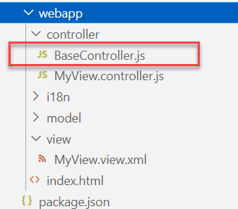
Concept of Base Controller in UI5
Base Controller:- A base controller is a controller with basic functionalities from which the other controllers in your SAPUI5 application inherit.
The base controller holds basic functionalities that are used across multiple controllers.
The base controller itself is just another JavaScript file and it does not have the .controller prefix. Just BaseController.js and not BaseController.controller.js.
The base controller goes in the controller folder in your SAPUI5 application folder structure:
sap/ui/core/mvc/Controller
x
BaseController
Template
x
Controller 1
x
Controller 2
x
Controller 3
x
Controller 4
View 1
View 2
View 3
View 4

Slide 4
Title
Content

Slide 5
Title
Content

Slide 6
Title
Content

Slide 7
Title
Content

Slide 8
Title
Content

Slide 9
Title
Content

Slide 10
Title
Content

Slide 11
Title
Content

Slide 12
Title
Content

Slide 13
Title
Content

Slide 14
Title
Content

Slide 15

End of Day 5

Slide 16

Questions

Slide 17

Anubhav Oberoy

Slide 18


We’re committed to empower you to be
Most Desirable Resource
through powerful training solutions.
We build the workforce of the future.
250+
Corporate Clients
30,000+
Learners Trained
25000+
Learners Placed
FREE WEBINARS
Sign up for free webinars with industry experts every fortnight!
Enroll Now!
Contact us today!
https://anubhavtrainings.com/

Slide 19




More from AnubhavTrainings.com

Slide 20
Title
Content

